Slide 1
WP 2: Mechanisms of conditioning and causal learning
lead: Tom Beckers (KU Leuven)

Slide 2
overall aim of WP2
double aim:
investigate involvement of “high-level” cognition in seemingly low-level associative learning phenomena
“are learning and conditioning more complex than we think?”
investigate possibility for associative learning in the absence of awareness
“can conditioning be more basic than we think?”
comparative / developmental perspective

Slide 3
3 lines of research
inference-making and rule learning in rat Pavlovian conditioning – are they like humans?
reliance of children’s causal learning on specific reasoning abilities – are they like adults?
learning and conditioning in the absence of awareness

Slide 4
3 lines of research
inference-making and rule learning in rat Pavlovian conditioning – are they like humans?
partners: KU Leuven (Beckers) / U Gent (De Houwer)
reliance of children’s causal learning on specific reasoning abilities – are they like adults?
partners: KU Leuven (Beckers) / U Gent (De Houwer)
with Teresa McCormack (QU Belfast)
learning and conditioning in the absence of awareness
partners: ULB (Peigneux) / KU Leuven (Beckers)

Slide 5
funding and staff
research on-going in all three lines
partly funded externally, partly through IUAP
line 1: all external staff
line 2: previously ESRC, 1 PhD student to be hired
line 3: external funding (Peigneux), 1 postdoc (Boddez)

Slide 6
inference-making and rule learning in rat Pavlovian conditioning
PIs: Beckers, De Houwer
researchers: Elisa Maes (FWO), Sarah Beurms (FWO)
three main subtopics:
forward blocking and inference
patterning in rats versus humans
equivalence and symmetry in rats – language without language?

Slide 7
1.1 forward blocking and inference
Discounting of X after A+/AX+ learning
Associative or inferential?

Slide 8
1.2 Patterning and rule-based generalization
Positive patterning: A- / B- / AB+
Negative patterning: A+ / B+ / AB-
Can be learned by humans and rats
Afterwards training of C+, D+, E-, F-
Responding to CD, EF?
Rule-based generalization vs. CD < EF
Perceptual generalization CD > EF

Slide 9
1.2 Patterning and rule-based generalization
Extensive evidence for rule-based generalization in humans
We just finished study that demonstrates that rats are inclined to perceptual generalization
On-going: testing in humans / sequential Bayesian model that combines model selection and weight updating
Next: pushing the limits

Slide 10
1.3 A hunt for symmetry in rats
Mastering equivalence: reflexivity, symmetry, transitivity
== = “apple”
reflexivity: A maps onto itself
symmetry: If A maps onto B, then B maps onto A
transitivity: if A maps onto B and B maps onto C, then A maps onto C

Slide 11
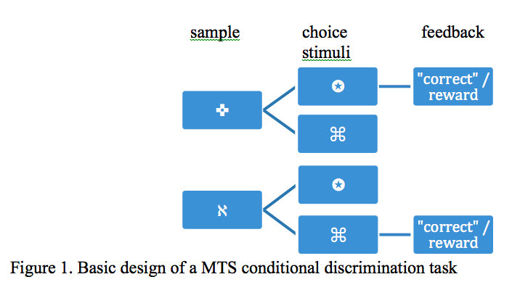
1.3 A hunt for symmetry in rats
MTS task: conditional choice

Slide 12
1.3 A hunt for symmetry in rats
In such MTS tasks, people readily exhibit reflexivity, transitivity, and symmetry
animals can do reflexivity and transitivity, but evidence for symmetry is very weak at best
equivalence needs language versus language results from equivalence
investigate role of factors that typically accompany language learning:
intermixed identity training
multiple exemplar training

Slide 13
2. Development of causal learning
PIs: Beckers, De Houwer, Teresa McCormack (Queen’s University Belfast)
researcher: PhD student to be hired
two main topics for now:
patterning (generalization) and development of reasoning abilities
does blocking reflect a lack of association – Pavlovian to Instrumental Transfer

Slide 14
3. Learning and conditioning in the absence of awareness
PIs: Peigneux, Beckers
Researchers: Mehdi Gilson, Juliane Farthouat, Yannick Boddez

