Slide 1
KU Leuven team – Learning and Psychopathology
PI Prof. Tom Beckers

Slide 2
composition of KU Leuven IUAP team
WP2
Tom Beckers
Yannick Boddez (IUAP / CfE)
Elisa Maes (FWO)
Sarah Beurms (FWO)
X (IUAP)
other WP
Frank Baeyens
Bram Vervliet
Kim Haesen

Slide 3
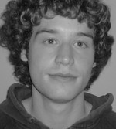
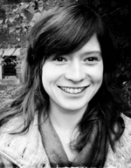
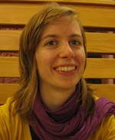
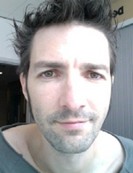
composition of KU Leuven IUAP team

Slide 4
core research topics
basic principles of psychopathology learning & conditioning
learning and memory
in fear and
addiction

Slide 5
core research topics
principles of learning and conditioning:
causal learning in humans, including development of causal learning (e.g., Boddez et al., 2011, JEP:ABP; McCormack et al., 2012, JEP:ABP; in press, JECP, QJEP)
rule learning and equivalence in rats (e.g., Beckers et al., 2006, JEP:G)
computational work (e.g., Lu et al., submitted)
ESRC research grant
FWO research grant

Slide 6
core research topics
psychopathology:
implicit processes in psychopathology (e.g., Hermans et al., 2010, BRAT; Willem et al., in press, PID)
theoretical models of psychopathology (e.g., Beckers et al., ENPP)

Slide 7
core research topics
intersection of learning and psychopathology:
fear learning in humans and animals (e.g., Beckers et al., 2013, BP; Boddez et al., 2012, Frontiers; Callaerts-Vegh et al., 2006, JoNS)
fear memory reconsolidation and prediction error (e.g., Sevenster et al., in press, Science; 2012, NLM)
appetitive conditioning in humans (e.g., Van Gucht et al., in press, Appetite; 2010, Emotion)
NWO Vidi program (University of Amsterdam)
KU Leuven Center for Excellence on Generalization in Ill Health and Psychopathology

