Slide 1
WP1: Mechanisms and dynamics of learning and consolidation of novel visual patterns
B. Rossion/P. Peigneux

Slide 2
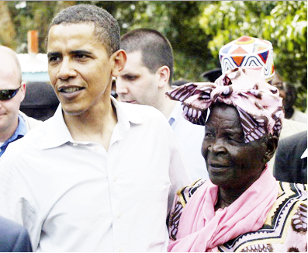
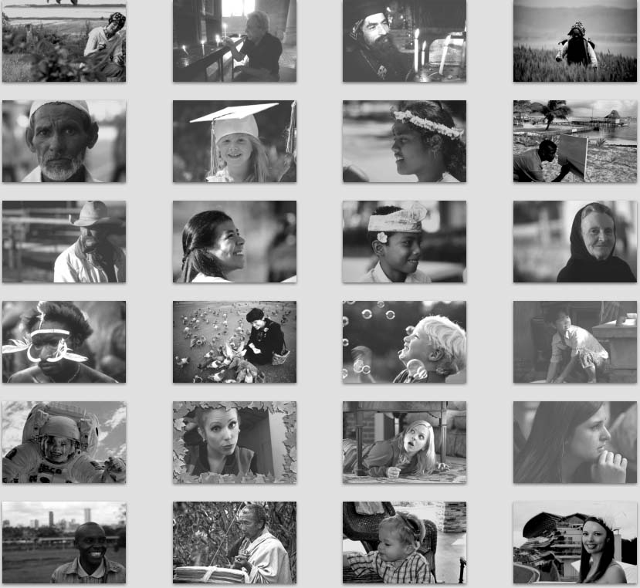
Visual patterns?
Human Faces
Are faces truly novel visual patterns?
Unfamiliar faces
Notes:
Burton slide

Slide 3
Individual faces are learned …
Effortlessly
Throughout the whole life
Consciously and (often) unconsciously
Excellent material for studying fundamental mechanisms of learning in humans

Slide 4
Face recognition
Classical distinction:
Perception = how do we build an image/representation of a face?
Memory = how do we encode, store and recall this image?

Slide 5
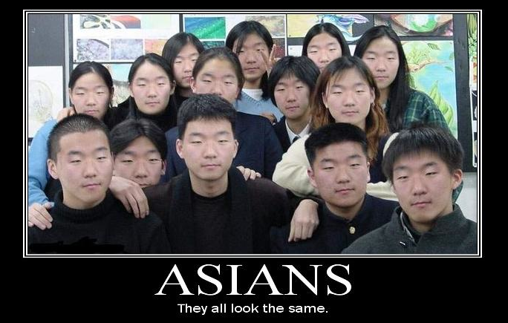
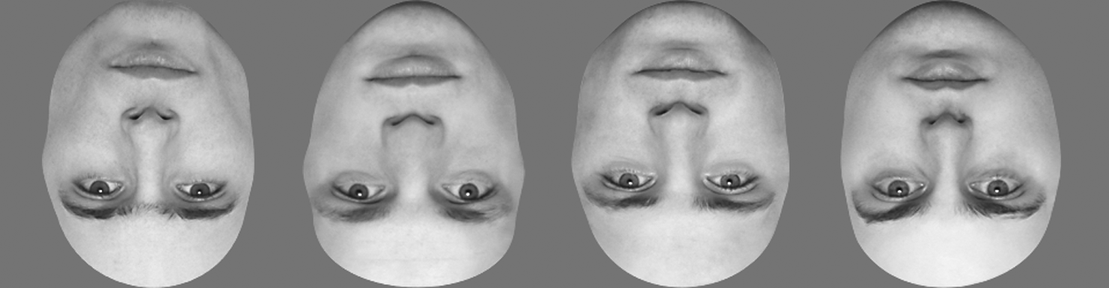
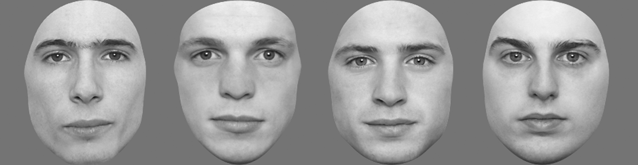
Are faces truly novel visual patterns?
Faces of another ethnical origin (“race”)
Inverted faces
+ novel shapes

Slide 6
WP1: Mechanisms and dynamics of learning and consolidation of novel visual patterns
B. Rossion/P. Peigneux

Slide 7
6 subpackages
WP1a. Behavioral characterization of the gradual installation of novel face representations
WP1b. Neural correlates of the installation of novel face representations
WP1c. Neural mechanisms and dynamics of face learning
WP1d. Effect of removal of typical interference at learning inexperienced face categories
WP1e. Consolidation processes across sleep and wakefulness
WP1f. Incidental learning of faces
+ 1 bonus: learning of novel visual shapes

Slide 8
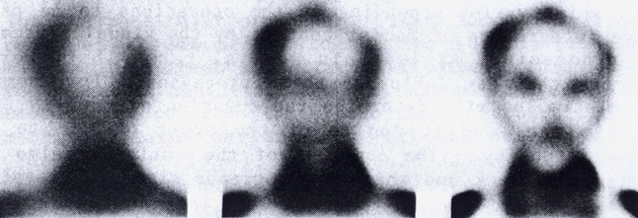
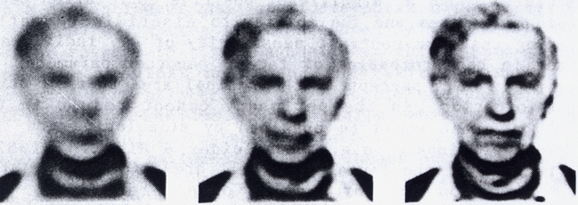
WP1a. Behavioral studies
Just how good are we at learning new faces?
What are the factors playing a role in learning new faces? (typicality, dynamic stimulation, emotional context)
Longitudinal studies
Notes:
Conscious learning of faces``
Factors: learning and recognition of atypical vs. typical faces[35]; faces presented in multiple or single
orientations at encoding; faces encoded as static patterns or as dynamic movies[36] as well as extrinsic factors:
Association of the face with a visual scene context, or with affective values. We will also test the hypothesis that
faces can be learned better if, at encoding, they are presented dynamically, just like they are supposed to be
perceived (i.e., from low to high spatial frequencies rather than the opposite

Slide 9
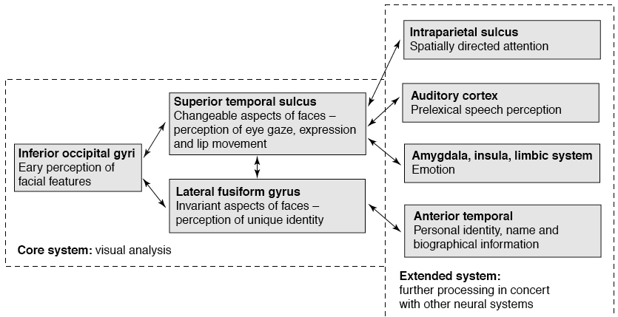
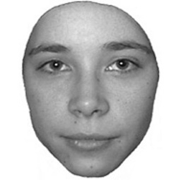
WP1b & c. Neuroimaging (fMRI)
Is there a strict division between brain regions involved in perception and memory of faces?
Haxby et al., 2000

Slide 10
WP1b & c. Neuroimaging (fMRI)
Is there a strict division between brain regions involved in perception and memory of faces?
What are the key regions involved in learning new faces?
How do these regions distinguish old from new faces?

Slide 11
WP1b & c. Neuroimaging (fMRI)
Is there a strict division between brain regions involved in perception and memory of faces?
What are the key regions involved in learning new faces?
Right temporal pole

Slide 12
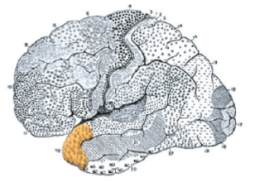
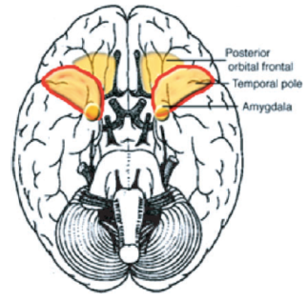

Slide 14
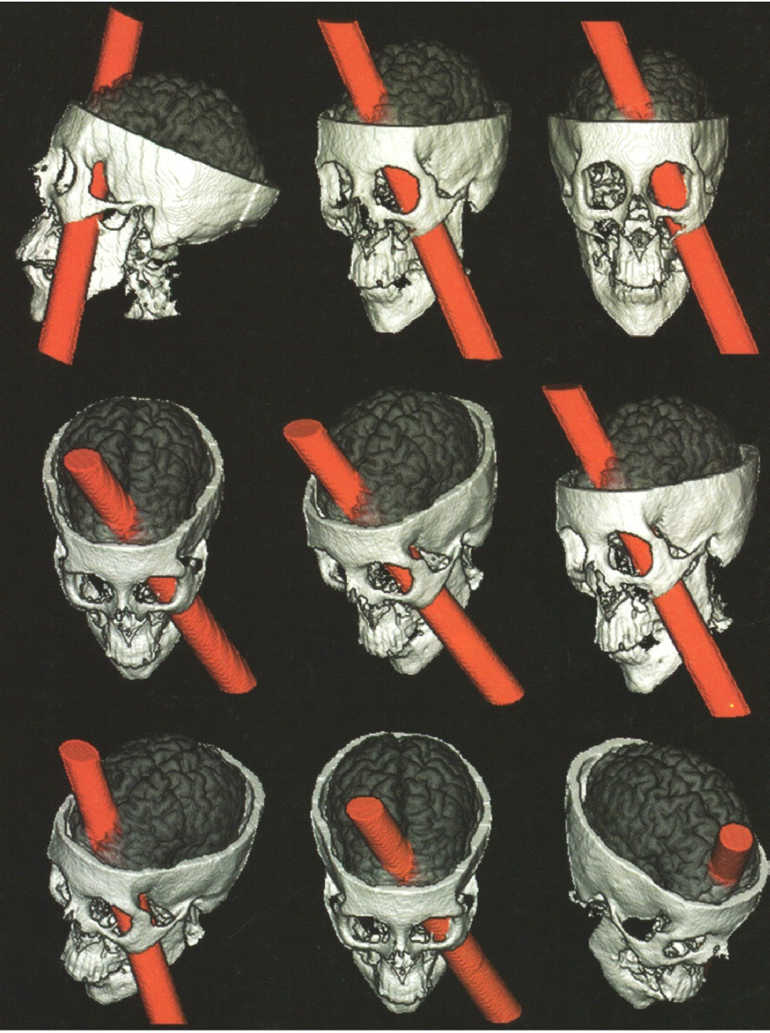
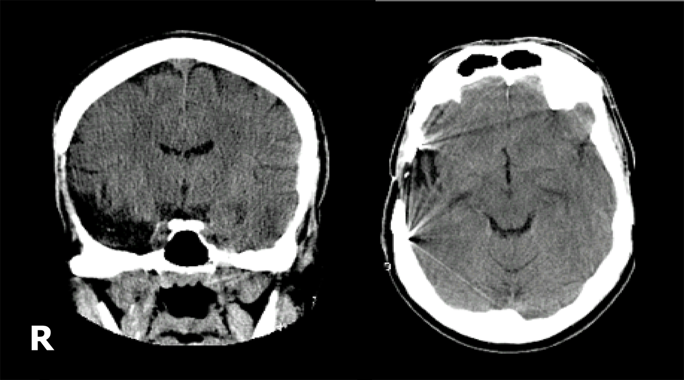
Critically involved in face recognition
Patient LR: Bukach et al., 2006

Slide 17
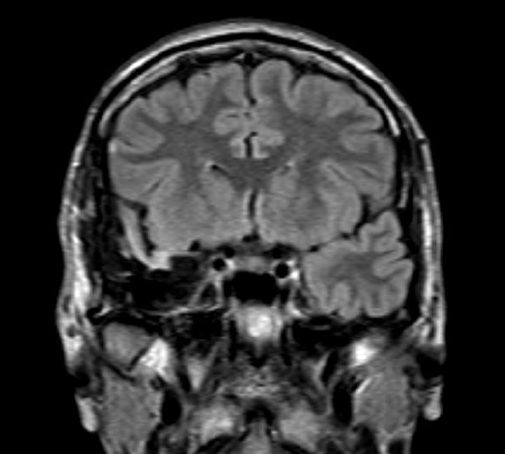
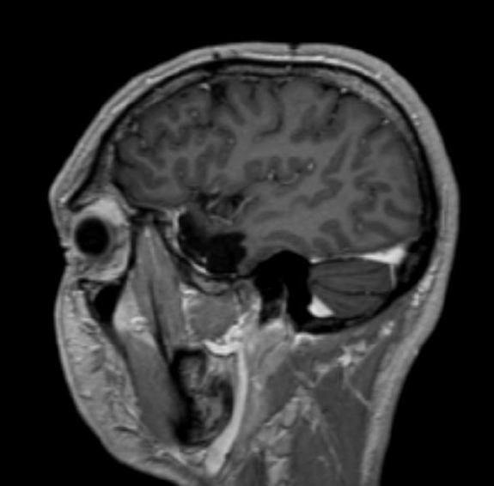
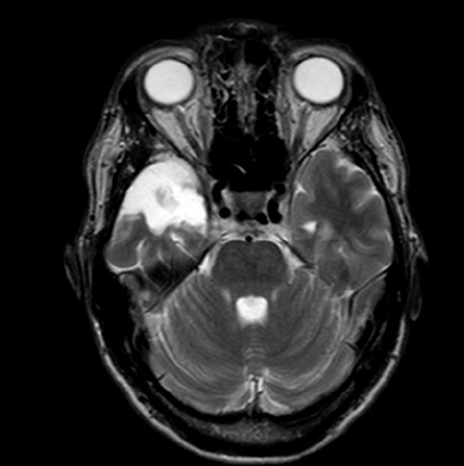
HR, 39 years old
Right anterior temporal lobectomy (2008)

Slide 18
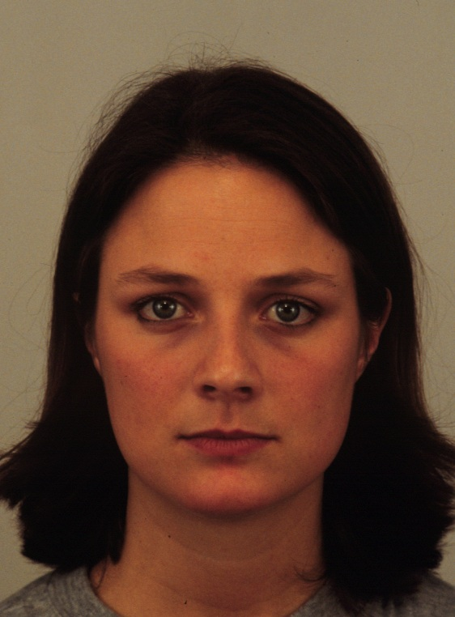
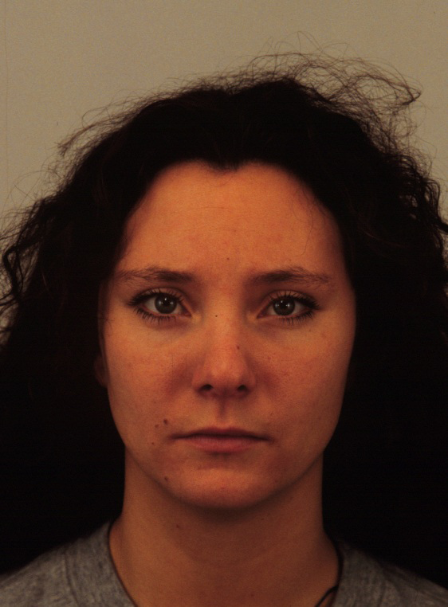
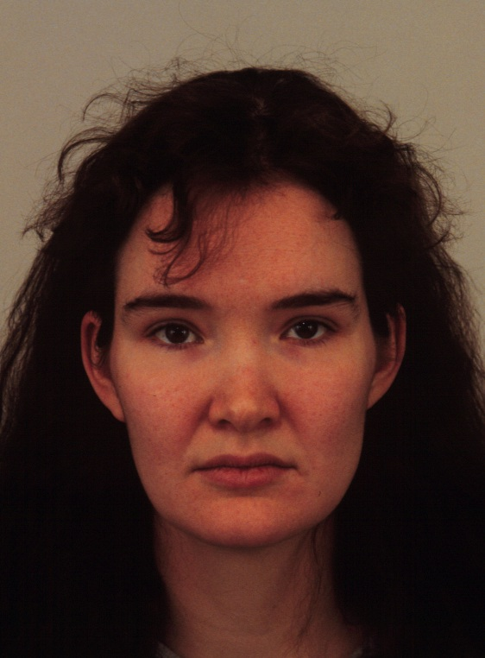
HR’s only complain since operation:
He cannot learn new faces !
Recognition of famous faces: perfect (98%, fast)
Old/new face discrimination task
Encoding
…
…
HR vs. controls
73% vs. 85%
6477 ms vs. 2027 ms

Slide 19
Yet, the function of this region in learning of faces or other visual patterns remains largely unknown because:
Very few patients
The damage following surgery usually concerns also the anterior hippocampus/amygdala
Few fMRI face studies with learning paradigms
Difficulty to measure good signal in this region in fMRI (magnetic susceptibility artifacts)
Notes:
Lisa: MCI patients

Slide 20
Other regions involved in face learning
(Right) Hippocampus: relational memory
Hippocampal morpho-functional changes in Alzheimer disease and aMCI
Difficulties in separating patterns
(should confuse new faces similar to old faces as previously seen)

Slide 21
WP1d & e. Learning new face patterns: role of sleep and interference
Role of post-training sleep for consolidation of learned faces
- Performance across sleep periods of the night: early (SWS) and late (REM)
Taking advantage of sleep-monitoring experiments to avoid interference
Learning of inverted faces; “other-race” faces, without exposure to upright faces between learning and test
Notes:
SWS: slow wave sleep

Slide 22
WP1d & e. Learning new face patterns: role of sleep and interference
Role of post-training sleep for consolidation of learned faces
- Performance across sleep periods of the night: early (SWS) and late (REM)
Taking advantage of sleep-monitoring experiments to avoid interference
Learning of inverted faces; “other-race” faces, without exposure to upright faces between learning and test
Notes:
SWS: slow wave sleep

Slide 23
Training adult participants with inverted faces
Laguesse et al., 2012
✔ Are as complex as upright faces
✔ Are perceived as faces and handled by the face processing system
Perret et al., 1988; Mazard et al., 2006; Yovel & Kanwisher, 2005.
YET
Violate the biological constraints of the visual system at birth
Are not experienced during development
Yin, 1969; Valentine, 1988.

Slide 24
Previous studies have been unsuccessful
Duration of training is short (1 to 10 hours)
Number of faces used in training is small (4 to 10 exemplars)
Exemplar-generalization was tested in one study (Hussain et al., 2009)
Using a small set of exemplars (10 exemplars)
Hussain, Sekuler & Bennett, 2009; Robbins & McKone, 2003;

Slide 25
General Procedure
Trained group (N = 8)
Control (untrained) group (N = 10)
Comport PRE
Comport POST
Pre-test D1
Post-test D14
1 2 3 4 5 6 7 8
Training
8 sessions - 2 hours/day

Slide 26
Pre- and Post-test : Measure the FIE
4AFC matching task with different sets used at pre- and pos-test
No ceiling effects with upright faces
Prevents image-based matching strategy

Slide 27
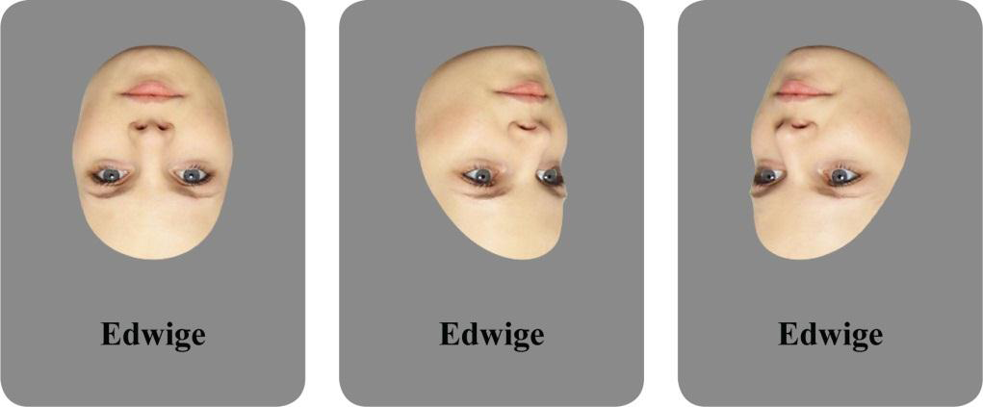
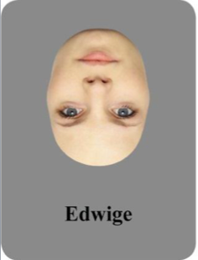
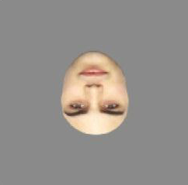
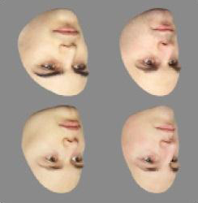
Training with inverted faces
30 face identities to be learned in 3 different viewpoints
3 different tasks
1. Exposure/Learning
Edwige
Edwige
Edwige
2. Naming
Correct
Edwige
Correct
Edwige
Correct
Edwige
Correct
Edwige
Name ?
Name ?
3. Old/New Discrimination task
Old/New?
Correct
85%
+ 4AFC matching task

Slide 28
Accuracy (%)

Slide 29
Accuracy (%)
FIE : Acc Up - Acc Inv

Slide 30
Accuracy (%)
FIE : Acc Up - Acc Inv
*
*
Three-way interaction significant, p = 0.001

Slide 31
We can learn to process inverted faces !
( short-term)
Long term learning?
Improves without interference from upright faces?
Role of sleep?
Dynamics and mechanisms of consolidation?

Slide 32
WP1f. learning faces without awareness
Should lead to overall lower recognition performance (reduced attention) than explicit learning
BUT: incidental learning is closer to the natural way in which faces are encoded?
More holistic than part-based?
Higher reliance on specialized structures?
Better assessment of Individual differences in the human ability to recognize faces than explicit learning?
Notes:
SWS: slow wave sleep

Slide 33
Fragile
The face recognition system can break down quite easily
Prosopagnosia (brain damage)
Congenital/developmental deficits in face recognition
Alzheimer disease, semantic dementia
Autism, …

