Slide 1
Mechanisms of Face Recognition
Bruno Rossion, UCL

Slide 2
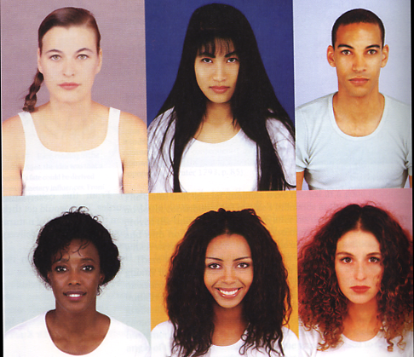
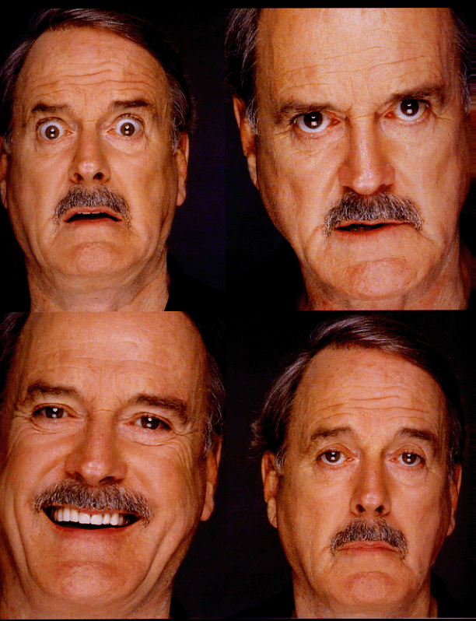
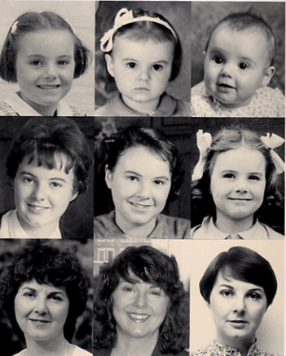
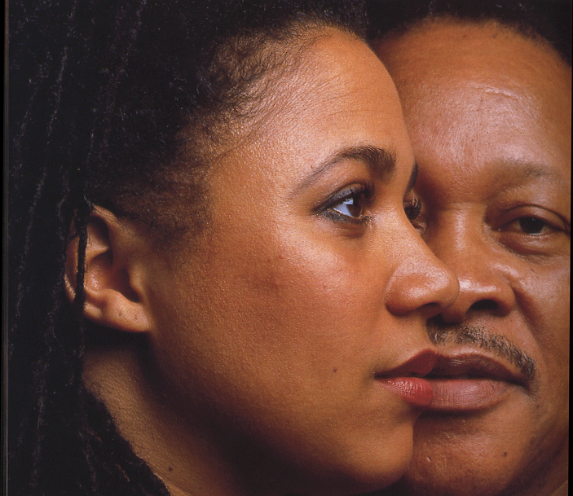

Slide 3
Developing early
With a long developmental course
(maturation in adulthood)

Slide 4
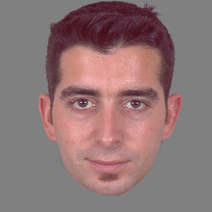
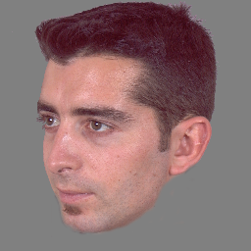
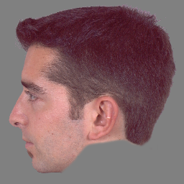
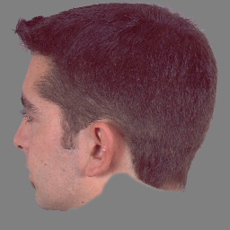
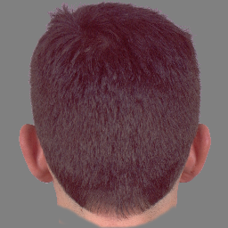
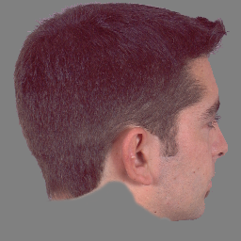
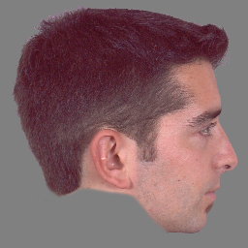
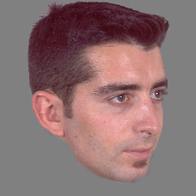
Difficult
Faces change all the time …

Slide 5
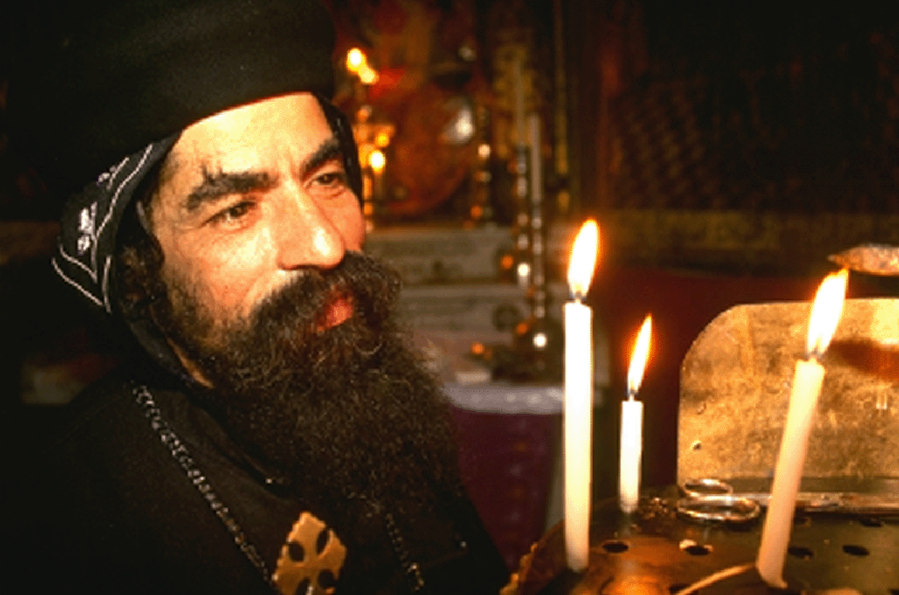
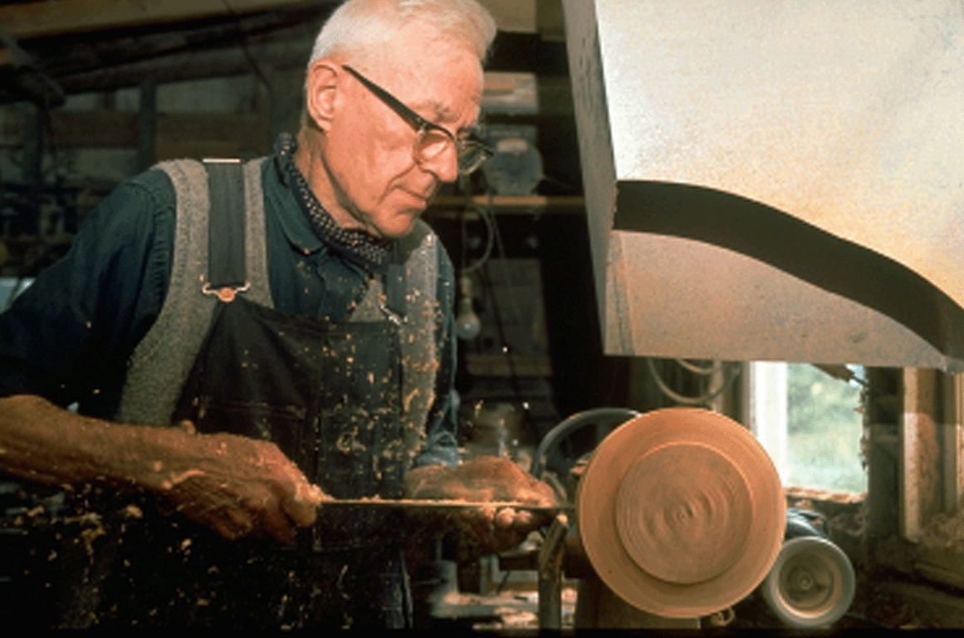
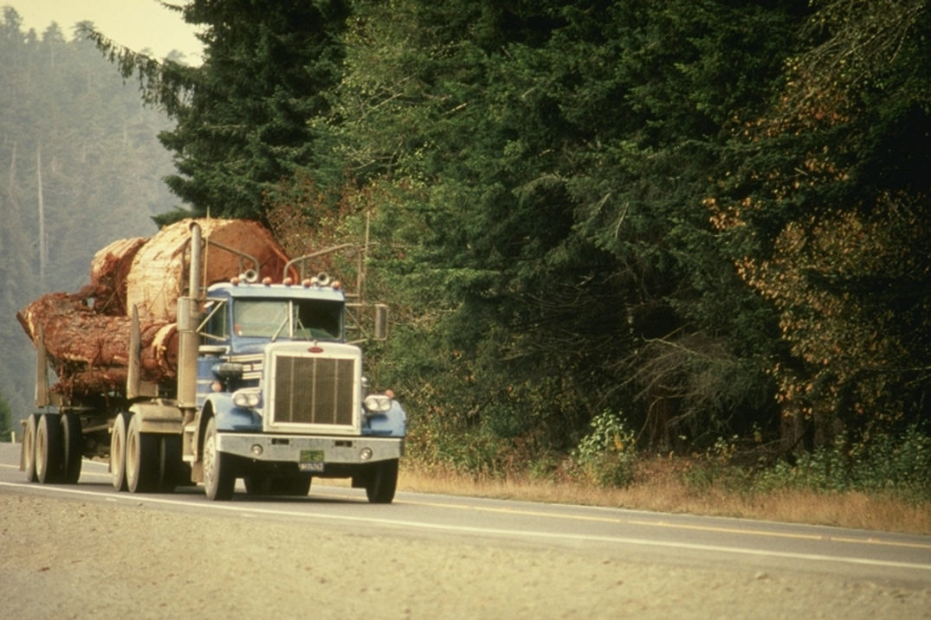
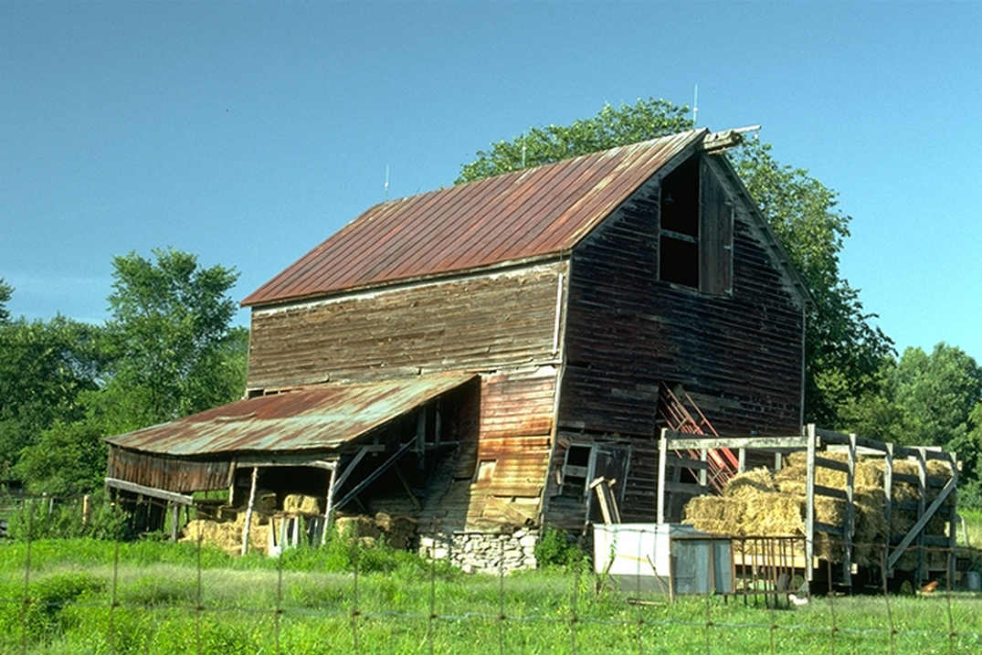
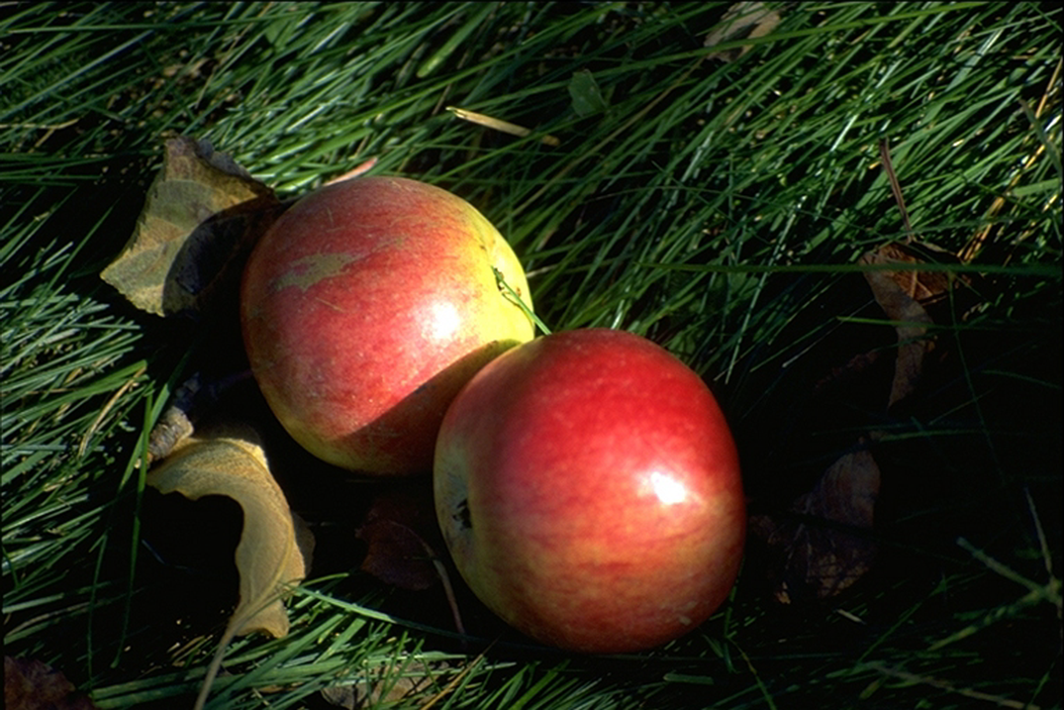
Very good and fast
Face detection in visual scenes
Rousselet et al., 2003: ~ 200 ms (manual RTs)
Crouzet et al., 2010: ~ 110 ms (saccadic RTs)

Slide 6
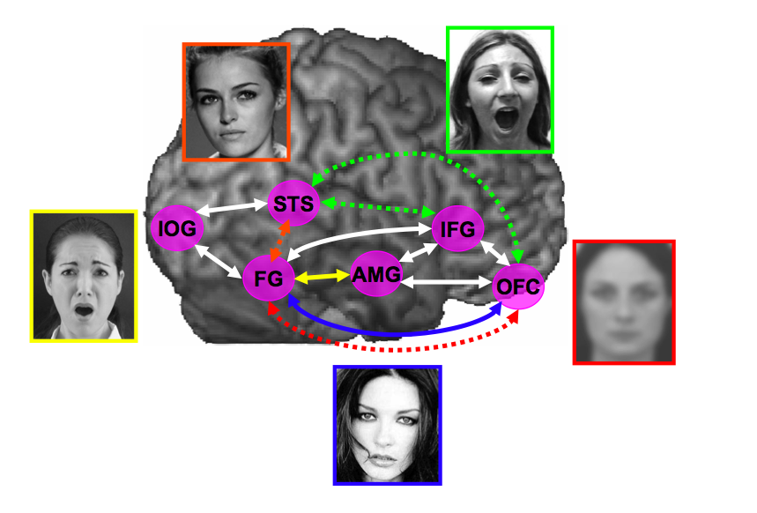
A large network of brain areas

Slide 7
Fragile
The face recognition system can break down quite easily
Prosopagnosia (brain damage)
Congenital/developmental deficits in face recognition
Alzheimer disease, semantic dementia
Autism, …

Slide 8
Face recognition
Classical distinction:
Perception = how do we build an image/representation of a face?
Memory = how do we encode, store and recall this image?
Notes:
J’ai change le titre, et je vais jongler entre les termes perception et memoire

Slide 9
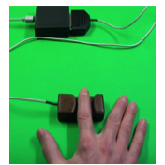
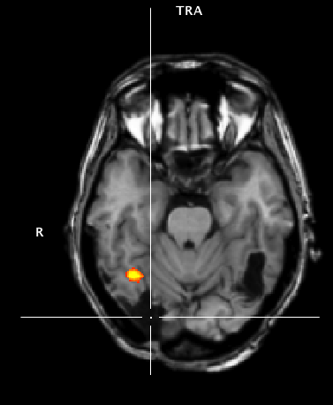
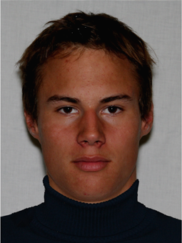
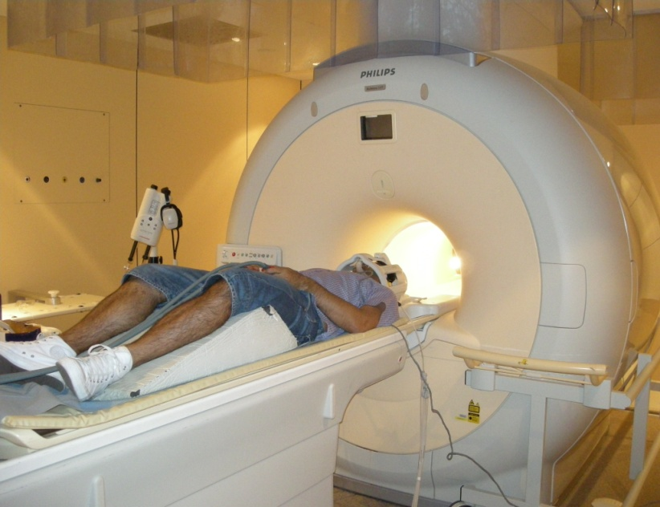
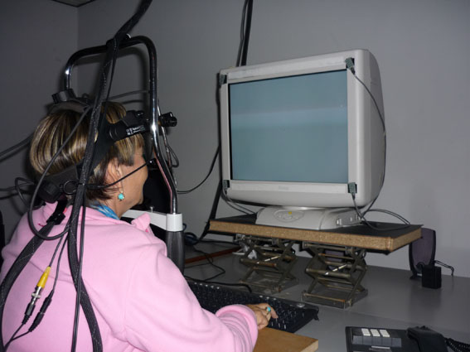
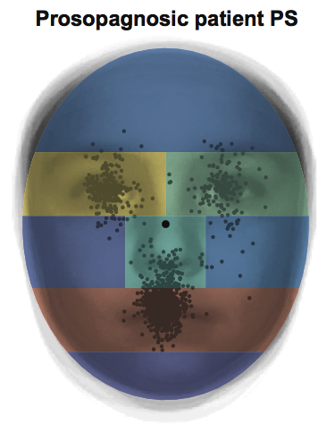
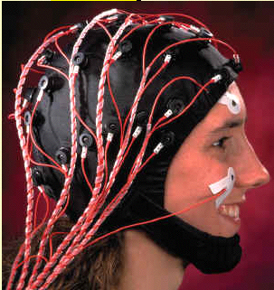
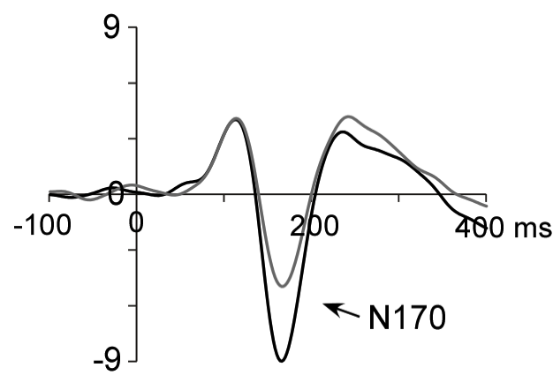
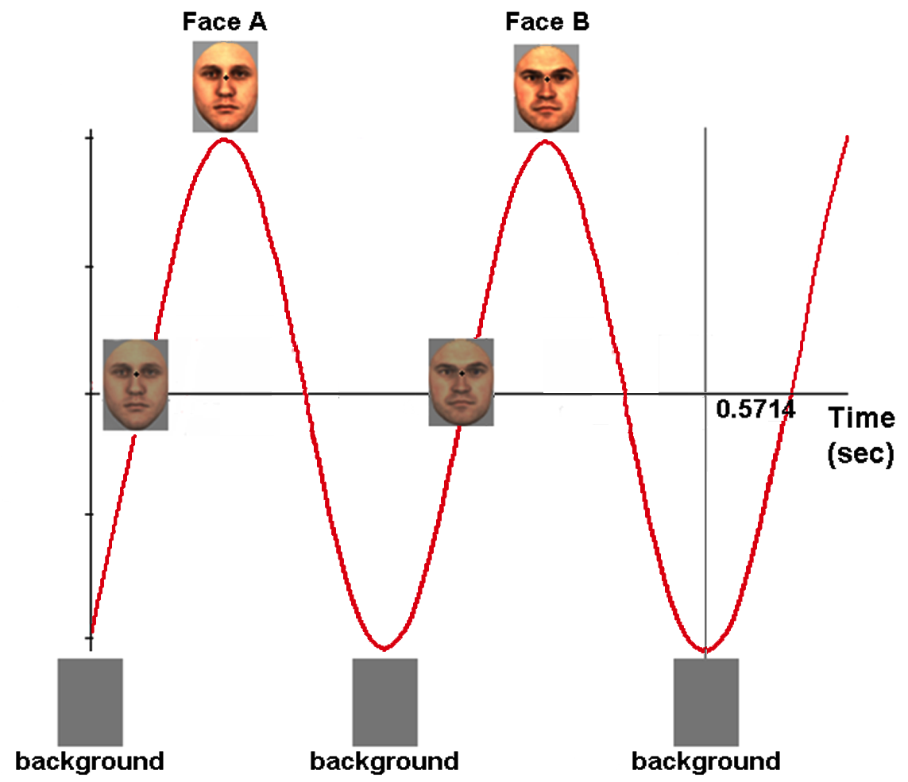
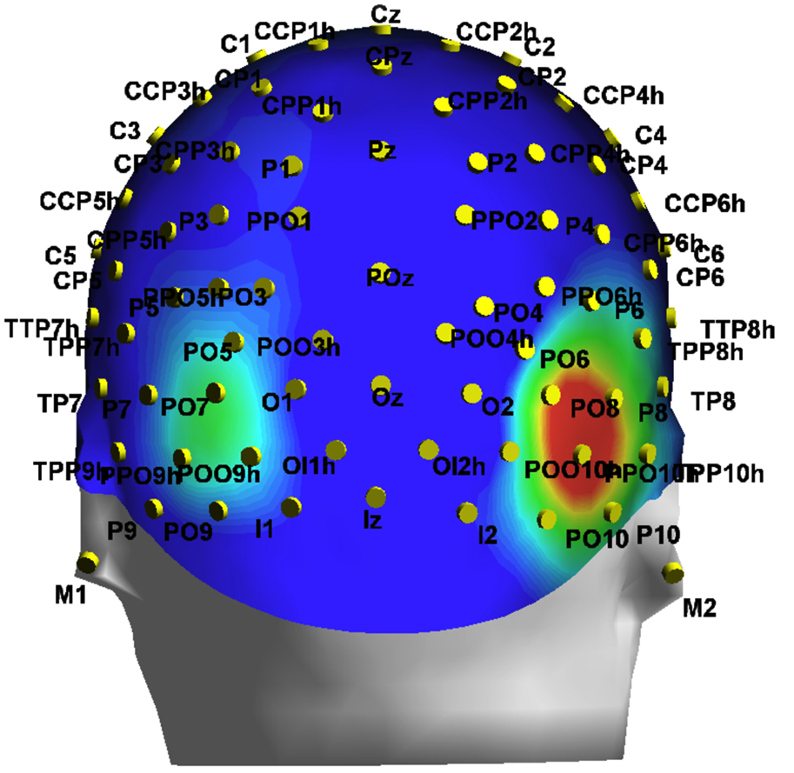
Mental Chronometry/Psychophysics
Brain-damaged patients (prosopagnosia)
Réponse
+
200
200-400
100
1500-1700 ms
Development
Neuroimaging (fMRI)
Intracerebral potentials
(epilepsy)
Monkey physiology
Eye-tracking
ERPs/EEG (ssVEP)

Slide 10
Analytical view of face perception
We explore a face element by element...
.. to extract the most diagnostic information

Slide 11
Eye movements
Diagnosticity of facial features
e.g., Sadr & Sinha, 2003
Yarbus, 1967
Smith et al., 2005
Notes:
These elements can also be relative distances between features that are treated locally
11

Slide 12
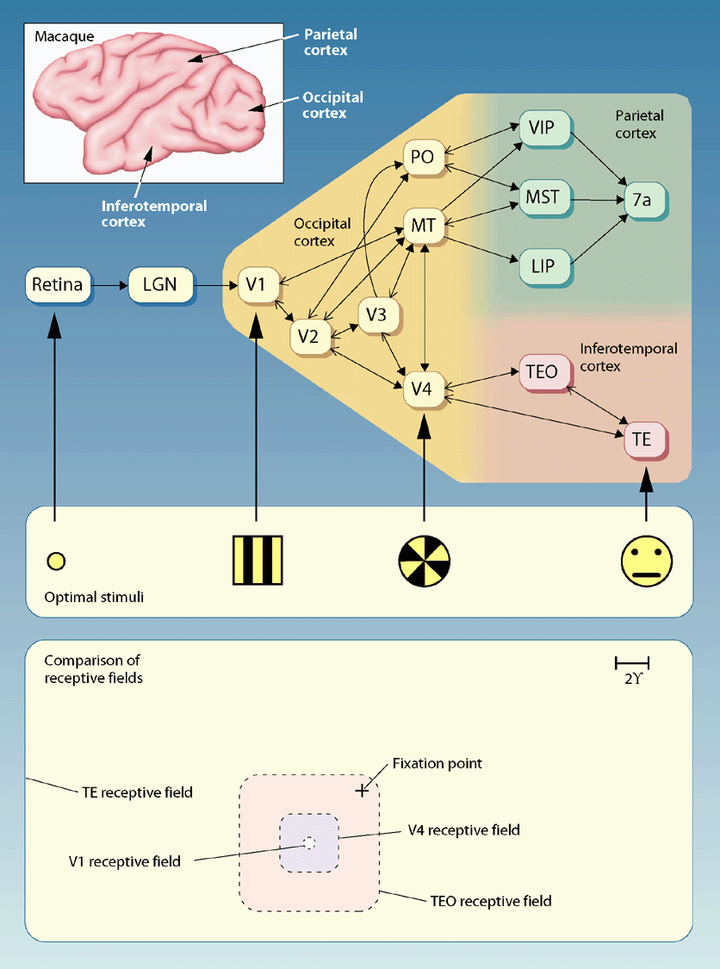
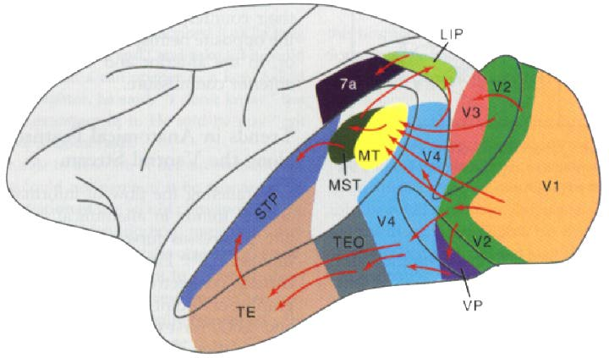
Neurophysiology

Slide 13
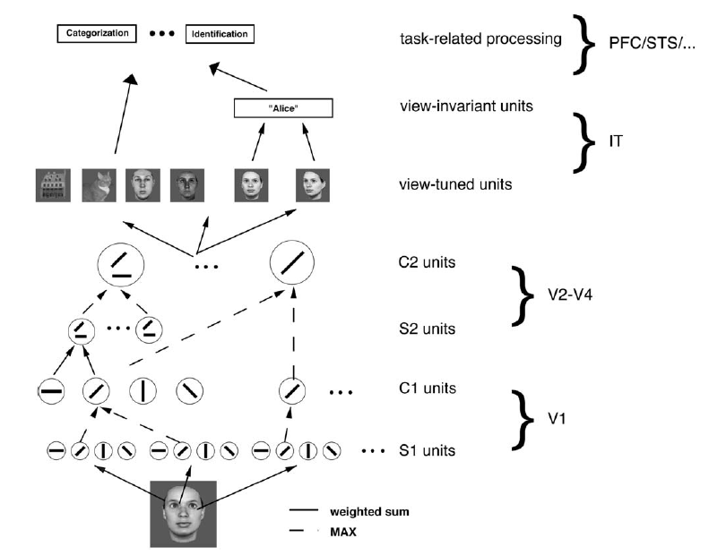
MAX model
Jiang et al., 2006

Slide 14
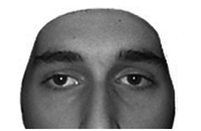
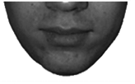
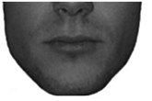
The composite face illusion
Young et al. (1987)

Slide 15
The composite face illusion
Young et al. (1987)

Slide 16
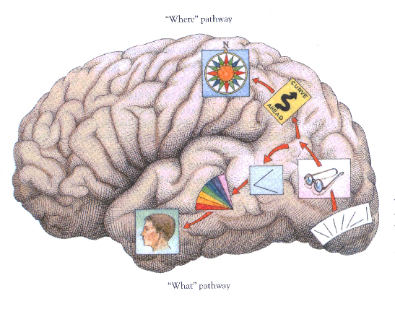
How does the human brain perceive a face as a whole?

Slide 17
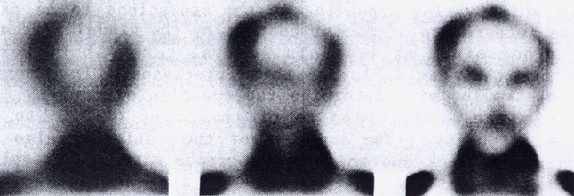
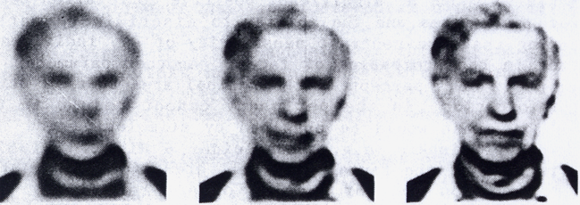
Sergent, 1986.

Slide 18
Current lab members
Adélaïde de Heering Postdoc
Giulia Dormal PhD student
Milena Dzhelyova Postdoc
Corentin Jacques Postdoc
Jacques Jonas PhD student
Francesco Gentile Postdoc
Renaud Laguesse PhD student
Joan Liu PhD student
Aliette Lochy Postdoc
Dan Nemrodov Postdoc
Lisa Quenon PhD student
Talia Retter PhD student
Jessica Taubert Postdoc
Katrien Torfs Postdoc
Goedele Van Belle Postdoc
Bruno Rossion (PI)

Slide 19
Current lab members
Adélaïde de Heering Postdoc
Giulia Dormal PhD student
Milena Dzhelyova Postdoc
Corentin Jacques Postdoc
Jacques Jonas PhD student
Francesco Gentile Postdoc
Renaud Laguesse PhD student
Joan Liu PhD student
Aliette Lochy Postdoc
Dan Nemrodov Postdoc
Lisa Quenon PhD student
Talia Retter PhD student
Jessica Taubert Postdoc
Katrien Torfs Postdoc
Goedele Van Belle Postdoc
Bruno Rossion (PI)

Slide 20
Collaborations with other institutions (main)
A.M Norcia (Stanford University, USA)
R. Goebel (University of Maastricht)
R. Vogels; W. Vanduffel (KUL)
Q. Vuong (Newcastle University, UK)
L. Maillard (Université de Lorraine, Nancy, France)
J. W. Tanaka (University of Victoria, Canada)

Slide 21
Sources of Funding
ERC Starting grant 2012-2017
FNRS (FRSM, individual fellowships)
FSR (UCL-Marie Curie postdoctoral fellowship)
PAI/IUAP

