Slide 1
WP6: Mechanisms of instrumental learning and the conscious experience of agency
Patrick Haggard & Nura Sidarus, UCL
Axel Cleeremans, ULB
Marcel Brass, UG

Slide 2
Research questions
Awareness of action:
Do we know what we are doing?
How do we know it?
When do we know it?
Why do we know it?
Notes:
IG/ET, Volition: Libet, Consciousness, H&E: selection, PD W, selection to do or not (veto), EEG.

Slide 3
Sense of Agency: the subjective experience that we have control over events in the world through our actions
Intention
Prospective
Retrospective
Movement
Effect
Notes:
3

Slide 4
Comparator models Blakemore, Frith, Wolpert, Proc Roy Soc 2000
Goal/
Intention
Planner
(Inverse model)
motor command
Action
World
efference copy
Prospective
prediction
Forward model
Retrospective
No Prediction Error: It was me!
sensory feedback
Perception
+ve Prediction Error: It was not me!
Agency is computed post-hoc and retrospectively
Notes:
4

Slide 5
Just know what to do...
“Intentional fluency”
Metacognitive readout of action selection processes
Notes:
Experience of agency/non-agency occurs BEFORE you press the button
Sometimes you just know what to do

Slide 6
Comparator models Blakemore, Frith, Wolpert, Proc Roy Soc 2000
Goal/
Intention
Planner
(Inverse model)
motor command
Action
World
efference copy
Prospective
prediction
Forward model
Retrospective
Feels like I’m in control
sensory feedback
Perception
Predictive component to sense of agency
Notes:
6

Slide 7
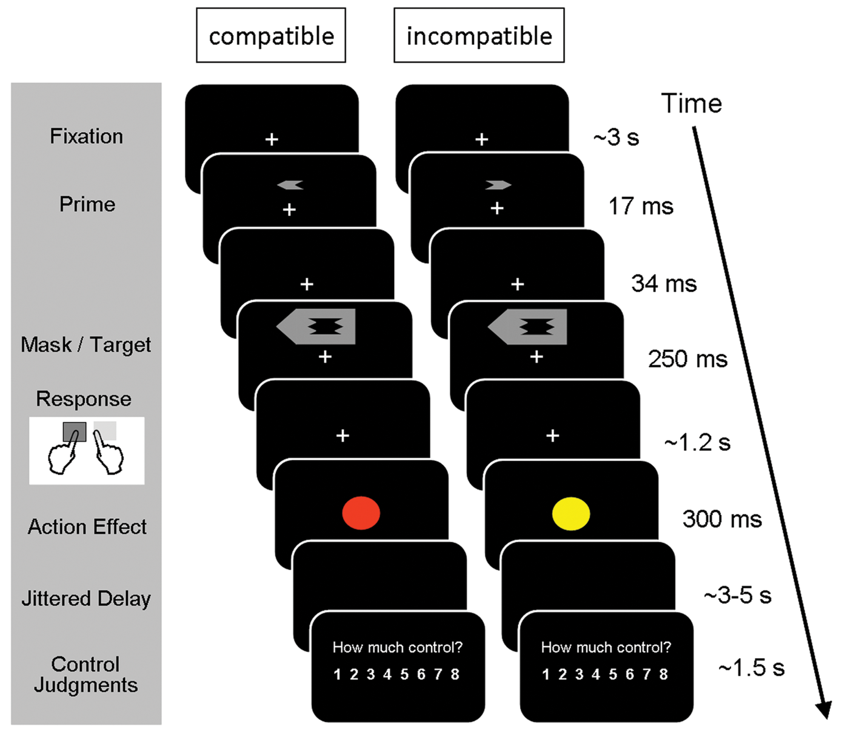
Experiment 1: Subliminally priming actions selection influences sense of agency
Subliminal primes
2AFC visual-motor task
Colour effect
Numerical rating
“how much control?”
Sense of control judgement:
1. Hand-colour relation (blocked)
2. Response-colour delay
(dummy)
3. Prime compatibility?
Primes by themselves do not predict effects
Compatible primes increase fluency of action selection
Notes:
Maybe when we condemn someone we condemn them for not have a brain mechanism that allowed them to learn. We can
Only do that if we give them a chance to learn!

Slide 8
**
**
Response Times
control
compatible
incompatible
compatible
incompatible
Subliminal priming influences action selection mechanisms…
… and increases perceived sense of agency over action effects
Action Priming → Fluent action selection → sense of control
Prospective, premotor contribution to sense of agency
Not effect prediction, not easily explained by reconstruction
Notes:
Maybe when we condemn someone we condemn them for not have a brain mechanism that allowed them to learn. We can
Only do that if we give them a chance to learn!

Slide 9
How are preconstruction and reconstruction combined?
Preconstruction
Intention Monitoring
Importance of intention
Reconstruction
Outcome Monitoring
Importance of action outcome

Slide 10
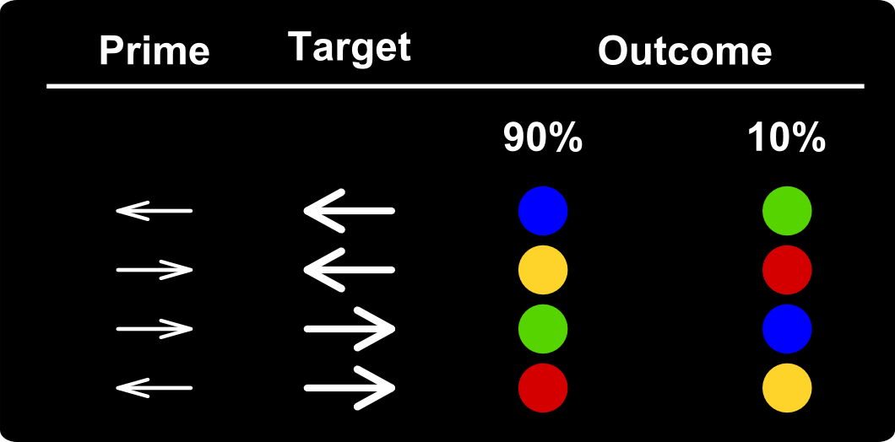
Experiment 2: Combining selection and reconstruction
1. Specify Action-Outcome contingency
2. Vary Action-outcome contingencies
90% contingency block
70% contingency block
50% (NO) contingency block
3. Test learning of action-outcome pairings after each block.

Slide 11
Results
Compatible priming influences RT
No effect of contingency
Contingency influences control
No effect of priming!!

Slide 12
Results
Compatible priming influences RT
No effect of contingency
Contingency influences control
No effect of priming!!
Conclusion: attending to outcomes abolished the effect of action selection on sense of agency
Preconstructive and reconstructive mechanisms are alternatives, not synergic

Slide 13
Experiment 3: What happens when outcomes are not as predicted?
Action-outcome contingency was always 67%
No test of action-outcome pairs
**
Conclusions:
Fluency of action selection contributes to sense of agency most when actions have surprising effects
Prospective agency may be an alternative to action-outcome matching

Slide 14
Relation to other partners
Priming (ULB)
WP6
Neuroimaging (Ugent)

Slide 15
Future research questions: 1
Do we learn to use metacognitive signals about action selection fluency? How does this learning occur?
Does sense of agency improve in other implicit learning situations such as sequential reaction tasks?

Slide 16
Future research questions: 2
What is the neural basis of “sense of agency” versus processing of agency-related cues?
fMRI study, using MVPA transfer
Fluent Action Selection Situation
Sense of Agency
Outcome Monitoring Situation
transfer
No transfer

Slide 17
Thanks!

