Slide 1
Mechanisms of implicit learning:
What sort of structures can be implicitly learnt?
(What sort of model would allow such learning?)

Slide 2
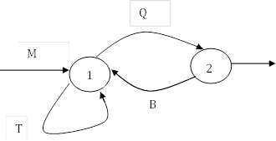
1. [0] -> M[1]
2. [1] -> T[1]
3. [1] -> Q[2]
4. [2] -> B[1]
[2] -> ε
[0], [1], [2] are non-terminals
Finite state grammar
Example string;
M[1]
-> MT[1]
-> MTT[1]
-> MTTQ[2]
-> MTTQ

Slide 3
MTTQ
People learn:
Chunks: MT, TT, TQ, MTT, TTQ
Whole items: MTTQ
Repetition structure: 1223 (so they can classify KXXV as grammatical)

Slide 4




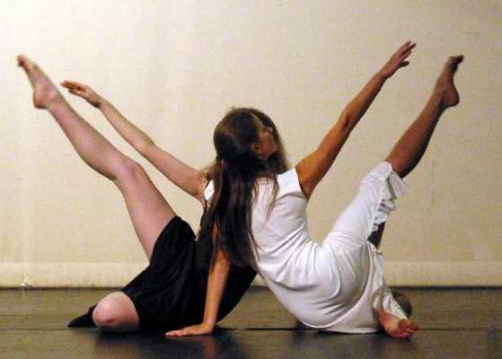
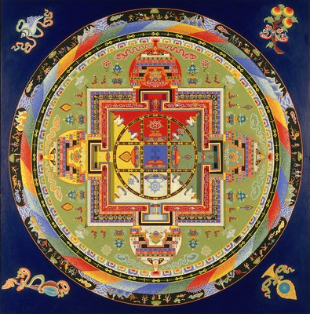
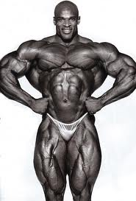

Slide 5
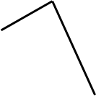






A2
A1
A1 A2 A3 - B1 B2 B3
A3
Cross serial dependency/ inversion
B3
mirror
B1
B2
A1 A2 A3 - B3 B2 B1
Centre embedding/ retrograde
mirror

Slide 6
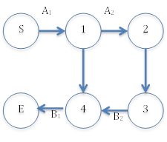
Retrograde symmetry:
A1A2A3-B3B2B1
1. [0] -> Ai[0]Bi
2. [0] -> ε
(where [0] is a non-terminal)
Context free grammar
Inverse symmetry:
A1A2A3-B1B2B3
1. S-> Ai S] Ti
2. S-> ε
3. Ai Tj -> Ai Bj
4. Bj Ti -> Ti Bj
(where Ti and S are non-terminals)
Context-sensitive grammar

Slide 7

Kuhn and Dienes 2005
Grammatical Tune showing inversion
Contour -3 +6 +1 +3 -6 -1

Slide 8
Kuhn & Dienes 2005
Liking ratings
Classification performance

Slide 9
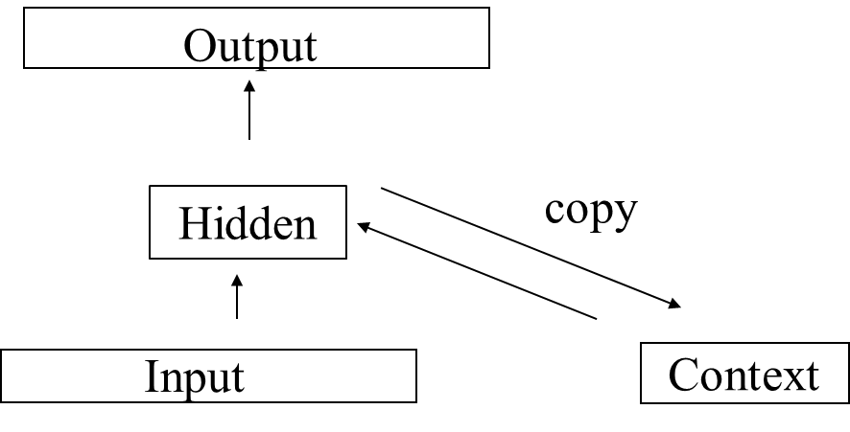
Kuhn and Dienes 2008
SRN learns fixed length long distance associations.
Have either subjects or SRN learnt a symmetry?
Need to show generalisation to new lengths.

Slide 11
火
心
水
気
木
地
金

Slide 12

火
心
水
気
木
地
金

Slide 13
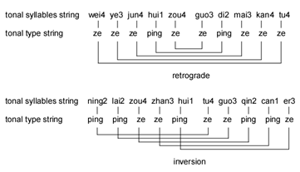

Tang poetry:
Divides Chinese tones (1-4) into two categories: ping (1,2) and ze (3,4)
And specifies an inversion relation in successive lines:

Slide 14
People can implicitly learn tonal inversions and retrogrades.
chunks and repetition structure are rigorously controlled.
People only learn when ping-ze classification is used
People can generalise from lines of 5 words to both 4 and 6 words – BUT with a major decrement
SRN characteristically shows all the above!!

Slide 15
Questions:
Can people be trained on different lengths so as to generalise with facility to longer poems? Can the SRN? (This is crucial for show the symmetry as such can be learnt)
Brain regions involved in learning symmetry versus chunking?
Cross cultural differences?
Can we induce symmetry learning in body movement and eye movements?

