Slide 1




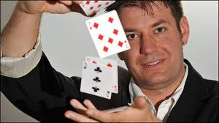
Mechanisms of implicit learning:
The nature of the structures that can be learnt; computational modelling
East China Normal University
Prof Xiuyan Guo
Dr Jinghua Tang
Dr Shan Jiang
Gustav Kuhn, Goldsmiths

Slide 2
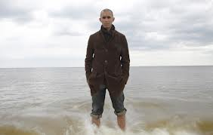
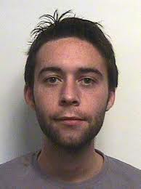
What is the difference between a conscious and unconscious mental state?
What methodologies should we use to measure that difference?
Dr Ryan Scott, Sussex
Prof Anil Seth, Sussex
Dr Andy Mealor, Sussex

Slide 3
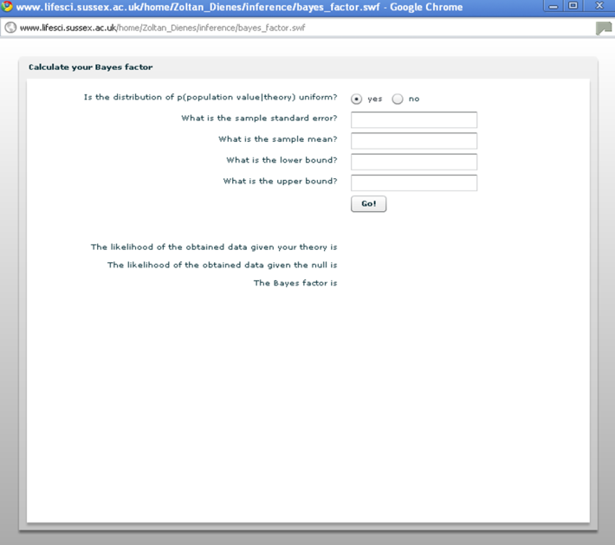
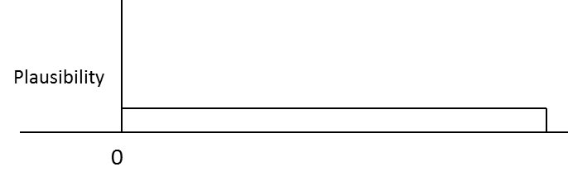
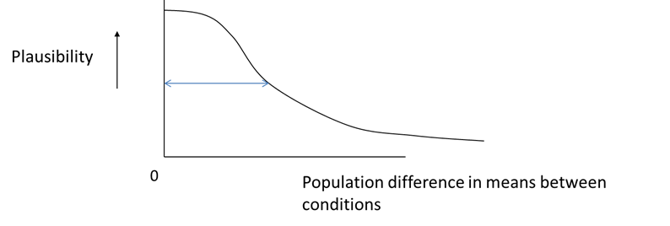

Establishing that a state is unconscious often involves asserting the null hypothesis.
Conventional statistics provides only awkward tools that often cannot work at all.
So Bayes is needed….
Estimated maximum effect
Estimated typical effect

Slide 4
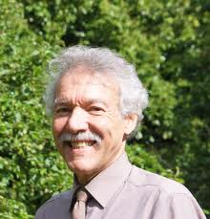
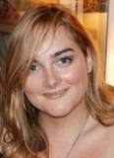
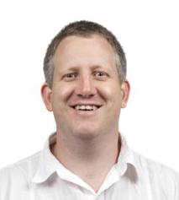
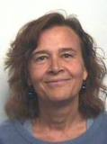
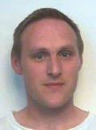
Hypnosis as unconscious executive intentions
(and as a means for creating other unconscious mental states?)
Dr Peter Naish, Sussex
Dr Rebecca Semmens-Wheeler, Sussex
Dr Ben Parris, Bournemouth
Prof Dora Duka, Sussex
Dr Sam Hutton, Sussex

